Slide 1
Principles of Economics
Lecture 4

Slide 2
THE MEANING OF MONEY
Money is the set of assets in an economy that people regularly use to buy goods and services from other people.

Slide 3
The Functions of Money
Money has three functions in the economy:
  Medium of exchange
  Unit of account
  Store of value

Slide 4
The Functions of Money
Medium of Exchange
  A medium of exchange is an item that buyers give to sellers when they want to purchase goods and services.
  A medium of exchange is anything that is readily acceptable as payment.
  Money is used as an medium of exchange for trade, in order to avoid the inefficiencies of a barter system.

Slide 5
The Functions of Money
Unit of Account
  A unit of account is the yardstick people use to post prices.
  A unit of account is a standard numerical unit of measurement of the market value of goods, services, and other transactions
Store of Value
  A store of value is an item that people can use to transfer purchasing power from the present to the future.

Slide 6
The Functions of Money
Liquidity
  Liquidity is the ease with which an asset can be converted into the economy’s medium of exchange.
  Because money is the economy’s medium of exchange, it is the most liquid asset available.

Slide 7
The Types of Money
Commodity moneyCommodity money is any money that is both used as a general purpose medium of exchange and as a tradable commodity in its own right.
It takes the form of a commodity with intrinsic value.
  Examples: Gold, silver
  Fiat money is used as money because of government decree.
  It does not have intrinsic value.
  Examples: Coins, currency, check deposits.

Slide 8
Money in the Economy
Currency is the paper bills and coins in the hands of the public.
Various forms of financial deposit accounts: such as demand deposits, savings accounts, and certificates of deposit.
Demand deposits are balances in bank accounts that depositors can access on demand by writing a check.
In modern economies, currency is the smallest component of the money supply.

Slide 9

Figure 1 Money in the Economy
Billions
of Dollars
M2
$5,455
•
Savings deposits
•
Small time deposits
•
Money market
mutual funds
•
A few minor categories
($4,276 billion)
M1
$1,179
•
Demand deposits
•
Traveler
’
s checks
•
Everything in M1
•
Other checkable deposits
($1,179 billion)
($599 billion)
•
Currency
($580 billion)
0
Copyright©2003 Southwestern/Thomson Learning

Slide 10
BANKS AND THE MONEY SUPPLY
Required Reserves are deposits that banks have received but have not loaned out.
In a fractional-reserve banking system, banks hold a fraction of the money deposited as reserves and lend out the rest.

Slide 11
BANKS AND THE MONEY SUPPLY
Reserve Ratio
  The reserve ratio is the fraction of deposits that banks hold as reserves.
  Reserve ratio, r= (required reserve/total deposit)×100

Slide 12
Money Creation with Fractional-Reserve Banking
  When a bank makes a loan from its reserves, the money supply increases.
  The money supply is affected by the amount deposited in banks and the amount that banks loan.
    Deposits into a bank are recorded as both assets(for customers) and liabilities(for banks).
    The fraction of total deposits that a bank has to keep as reserves is called the reserve ratio.
    Loans become an asset to the bank.

Slide 13
Money Creation with Fractional-Reserve Banking
This T-Account shows a bank that…
  accepts deposits,
  keeps a portion
  as reserves,
  and lends out
  the rest.
  It assumes a
  reserve ratio
  of 10%.
First National Bank
Assets
Liabilities
Reserves
$10.00
Loans
$90.00
Deposits
$100.00
Total Assets
$100.00
Total Liabilities
$100.00

Slide 14
Money Creation with Fractional-Reserve Banking
When one bank loans money, that money is generally deposited into another bank.
This creates more deposits and more reserves to be lent out.
When a bank makes a loan from its reserves, the money supply increases.

Slide 15
The Money Multiplier
How much money is eventually created in this economy?

Slide 16
The Money Multiplier
The money multiplier is the amount of money the banking system generates with each dollar of reserves.

Slide 17
The Money Multiplier
First National Bank
Second National Bank
Assets
Liabilities
Assets
Liabilities
Reserves
$10.00
Loans
$90.00
Deposits
$100.00
Reserves
$9.00
Loans
$81.00
Deposits
$90.00
Total Assets
$100.00
Total Liabilities
$100.00
Total Assets
$90.00
Total Liabilities
$90.00
Money Supply = $190.00!

Slide 18
The Money Multiplier
The money multiplier is the reciprocal of the reserve ratio:
M = 1/r
With a reserve requirement, r = 20% or 1/5,
The multiplier is 5.

Slide 19
The Central Bank’s Tools of Monetary Control
The Central Bank has three tools in its monetary toolbox:
  Open-market operations
  Changing the reserve requirement
  Changing the discount rate

Slide 20
Money Supply, Money Demand, and Monetary Equilibrium
Money demand has several determinants, including interest rates and the average level of prices in the economy.
People hold money because it is the medium of exchange.
  The amount of money people choose to hold depends on the prices of goods and services.
In the long run, the overall level of prices adjusts to the level at which the demand for money equals the supply.

Slide 21
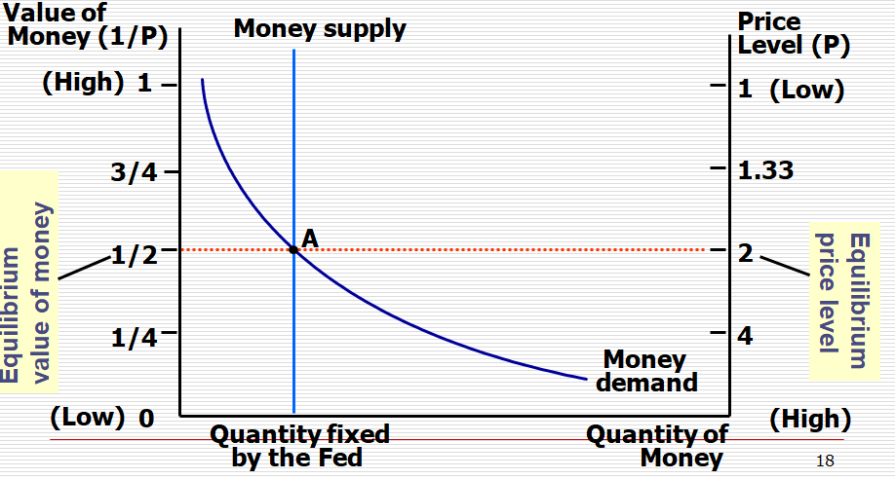
Money demand, money supply and equilibrium price level

Slide 22
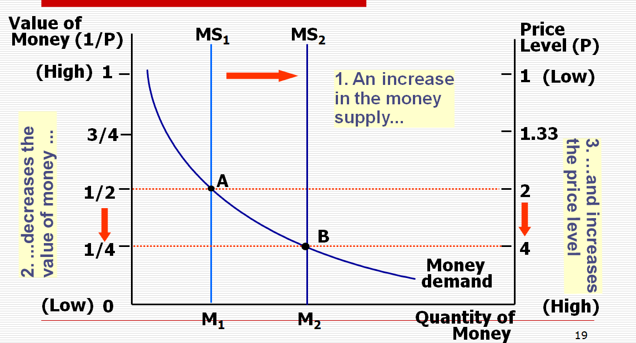
The effects of monetary injection

Slide 23
The Central Bank’s Tools of Monetary Control
Open-Market Operations
  The Central Bank conducts open-market operations when it buys government bonds from or sells government bonds to the public:
    When the Central Bank buys government bonds, the money supply increases.
    The money supply decreases when the Central Bank sells government bonds.

Slide 24
The Central Bank’s Tools of Monetary Control
Reserve Requirements
  The Central Bank also influences the money supply with reserve requirements.
  Reserve requirements are regulations on the minimum amount of reserves that banks must hold against deposits.
  r 1= 10%, required reserve=10, loan= 90
  r 1 =5%, required reserve= 5, loan = 95
  r 1 decreases, money supply increases

Slide 25
The Central Bank’s Tools of Monetary Control
Changing the Reserve Requirement
  The reserve requirement is the amount (%) of a bank’s total reserves that may not be loaned out.
    Increasing the reserve requirement decreases the money supply.
    Decreasing the reserve requirement increases the money supply.

Slide 26
The Central Bank’s Tools of Monetary Control
Changing the Discount Rate
  The discount rate is the interest rate the Central Bank charges banks for loans.
    Increasing the discount rate decreases the money supply.
    Decreasing the discount rate increases the money supply.
    Discount rate decreases, commercial banks take more loan, they can lend out large amount of money , money supply increases.

Slide 27
Summary
The term money refers to assets that people regularly use to buy goods and services.
Money serves three functions in an economy: as a medium of exchange, a unit of account, and a store of value.
Commodity money is money that has intrinsic value.
Fiat money is money without intrinsic value.

Slide 28
Summary
When banks loan out their deposits, they increase the quantity of money in the economy.
Because the Central Bank cannot control the amount bankers choose to lend or the amount households choose to deposit in banks, the Central Bank control of the money supply is imperfect.

